Slide 1
Make to Innovate
Mid-Term Review – Spring 2019
Boeing Electric Flight

Slide 2
Agenda
Project Overview
Design Review
Design Constraints
Current Design
Proposed Changes
Design Risks
Budget Status
Conclusion
Activity Report
Project Photo
Advisers and Stakeholders
Organization Chart
Project Plan
Milestones
Task Breakdown
Project Health Report
Design Re-cap
Status
Requests

Slide 3
Project Overview
Project Executive Summary

Slide 4
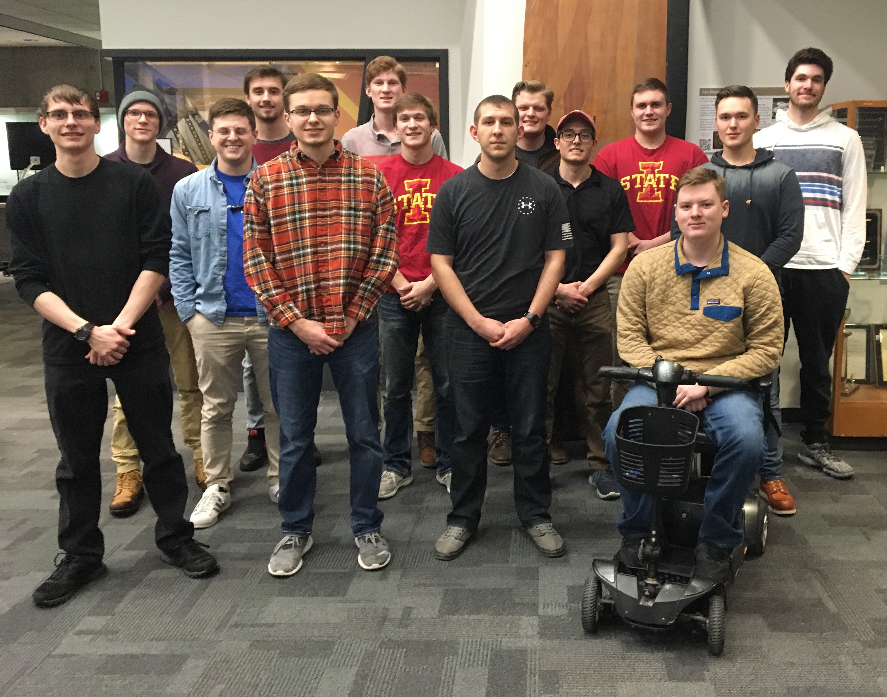
Project Overview
Project Photo
From Left to Right:
Robert Schorr, Joseph Weikert, Matthew Kreul, Garrett McCrea, Alex Britton, Drake Stuesse, Garrett Maakestad, Tyler Mains, Connor Montang, Joshuah King, Jarod Gill, Jason Kelly, Matthew Nord, and Alexander Kogut

Slide 5
Project Overview
Project Faculty Adviser
Dr. Leifur Leifsson
Project Technical Advisers
Ryan Engel - Boeing
Project Team Lead
Project Stake Holders
Alexander Britton – Chemical Engineering
M:2:I, Boeing
Project Overview

Slide 6
Project Organization Chart
Project Leader
Alex Britton
Battery Team Leader
Jason Kelly
CAD/Build Team Leader
Tyler Mains
Aircraft Design Team Leader
Robert Schorr
Battery Team Members
John Nownes
Connor Montang
John Ludeman
Matthew Nord
Aircraft Design Team Members
Joshuah King
Michala Ouverson
Jarod Gill
Drake Stuesse
CAD/Build Team Members
Garrett Maakestad
Garrett McCrea
Alexander Kogut
Matthew Kreul
Joseph Weikert

Slide 7
Project Plan
Project Mission
Semester Goals
Semester Deliverables
The overall mission for the Boeing Electric Flight project is to explore the viability of an all-electric commercial aircraft designed to replace a Boeing-737 aircraft with comparable mission.
This semester we are conducting finite element analysis on our wing designs, as well as conducting preliminary research into a thermal cooling system for our plane. Additionally, we are developing a safety procedure and components outline, and modeling a packaging system for out battery. We are also finishing preliminary testing and researching new foam to use to build our wing designs and then conduct wind tunnel testing with our designs attached to the plane.
This semester we will deliver an analysis of the micromechanics of our wing with numerical data from ANSYS. We will also deliver preliminary research regarding our advanced cooling system. A safety plan detailing specific processes and components that are solutions to unique battery powered aircraft problems will be provided, as well as a virtual model of the battery compartment.

Slide 8
Activity Report
Milestones, Tasks, and Health Report

Slide 9
Milestones
Aircraft Design Team
Battery Team
CAD/Build Team
Complete preliminary research of an advanced cooling system
Conduct finite element analysis on our designed wings
Develop a safety plan that outlines procedures and components which solve problems that are uniquely presented by an electric aircraft
Design a virtual model of the multiple on-board battery packaging systems using SolidWorks
Complete initial testing of the RC plane and research potential foam to purchase
Build wings out of purchased foam and attach to RC plane to go through final testing

Slide 10
Task Breakdown

Slide 11
Project Health Report
N/A
Ordering materials and Cutting out wing designs
All other tasks are on track

Slide 12
Design Review
Overview

Slide 13
Milestones: Aircraft Design
Complete preliminary research of an advanced cooling system
Make electric flight feasible by innovative design
Conduct finite element analysis on our designed wings
ABACUS for composites analysis
Analysis on box, swept and high aspect ratio wings
ANSYS for micromechanics model
Obtaining the shear modulus of the material

Slide 14
Milestones: Battery
Develop the outline of a safety plan
Look into issues unique to an electric aircraft
Response of ground crew
Design the battery packaging system using SolidWorks
Secures the batteries during flight
Easily transfer drained batteries in-between flights

Slide 15
MIlestones: CAD/build
Finish initial RC plane testing and research new foam material
Will determine an idea of how dense our current foam material is and how dense the new foam should be to build the wings out of it
Build wings out of purchased foam and attach to RC plane to go through wind tunnel testing
Will allow us to conduct testing on our wings that have been designed by the Aircraft Design team

Slide 16
Design Review
Constraints

Slide 17
Design Constraints
Manufacturability of certain types of foam
Styrofoam is likely to tear when milling our wings
RC Plane Motor
Not capable of flying the airplane with blue foam wings

Slide 18
Design Review
Current Design

Slide 19
Current Design: Aircraft Design
2 milestones
Research on cooling system
Investigate the effects of heat exhaust out of wings
Investigate materials that may be capable of needs
Investigate propulsion systems and the effects on them
Finite Element Analysis (FEA)
Micromechanics
ANSYS
Composites analysis
ABACUS
Notes:
Robert

Slide 20
Preliminary research
Currently in the process of researching an advanced cooling system for our batteries
Expel excess heat out of our wings
Effects on distributed electric propulsion
Look into research by other groups
NASA
Boeing
Collins Aerospace
Northrop Grumman
Notes:
Michala

Slide 21
Preliminary research
Materials research on cooling system
Investigate potential materials fitting needs
High energy transfer rate
Structurally strong at temperature
Light weight
Cost effective
Possibly mix of materials
Notes:
Jarod

Slide 22
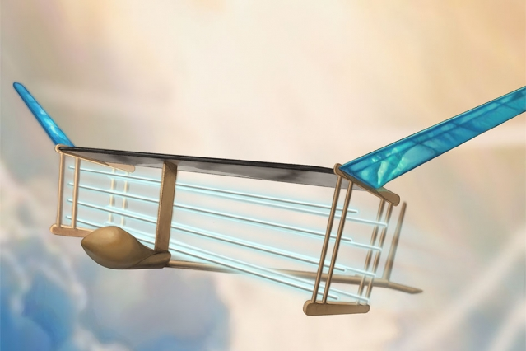
Preliminary research
MIT electric aircraft
Ionic wing propulsion
Scalability
Operational capabilities
Notes:
Drake
Image From: http://news.mit.edu/2018/first-ionic-wind-plane-no-moving-parts-1121

Slide 23
Finite element analysis
Micromechanics analysis
Find shear modulus
Find Poisson ratio
Wing structural analysis
Take micromechanics data for import
Have directional elastic moduli, shear modulus and Poisson ratios
Analyze wing structure with aluminum core
Notes:
Josh

Slide 24
Current Design: Battery
We started off with our two milestones
Develop a safety plan that outlines both components and procedures unique to a battery powered aircraft
Emergency landing procedures
Battery redundancy
Create a final packaging system
Recently started researching how a variety of different cargo carriers currently transport cargo within an aircraft's cargo hold
Will begin designing a virtual model in SolidWorks

Slide 25
Safety Plan and Components
There are two main topics for the safety plan and components
Emergency Landing
Available runways
Fire and Rescue requirements
Battery Redundancy
Ability to switch power source mid-flight
Advantages of switching power sources mid-flight

Slide 26
Emergency Landing Procedures
An all-electric airplane would have specific landing parameters
Research how constant weight influences landing factors
Runway length requirement for landing the plane
Designed landing weight
Implement an emergency landing plan based on these factors
Maintain proper fire retardant
Train airport firefighters

Slide 27
Battery Redundancy
Looking into whether we would be able to isolate different batteries within similar systems
This will help us isolate any fires and prevent it from spreading to other parts of the plane
Important from a safety standpoint
Physical Battery Cut-off
Low Voltage First Responder Wire

Slide 28
Final Packaging system
Design the packaging system used to store the batteries during flight
Emphasis on the ability to swap batteries quickly on the ground
Try to reduce the turnaround time compared to current commercial aircraft
40-60 minute turnaround time for current airliners
Currently considered Ideas
777 Power loading like system
Belt feed system

Slide 29
Current Design: CAD/Build
2 milestones
Complete initial testing of the foam and research new foam to purchase
Build our designed wings and conduct final testing on our RC plane

Slide 30
Initial Testing and Foam Research
Our initial testing consisted of density calculations for our current blue foam
This number was determined to be 171.7 kg/m³
This is too dense for our airplane to fly
We need a foam that is less dense than this
Originally planned on purchasing styrofoam to cut

Slide 31
Foam Research
Researched many different factors and properties of the foam, which include:
Density of the foam
Firmness/deflection of the foam
Tensile strength
The foam's R-value
Temperature range at which the foam starts to melt
Price
Manufacturability of the foam

Slide 32
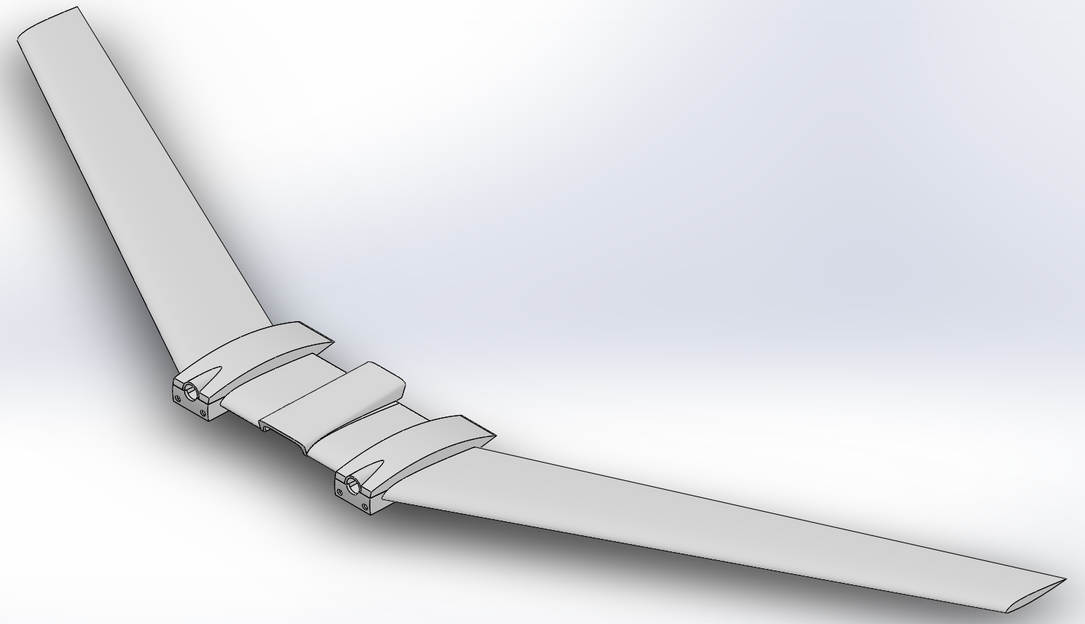
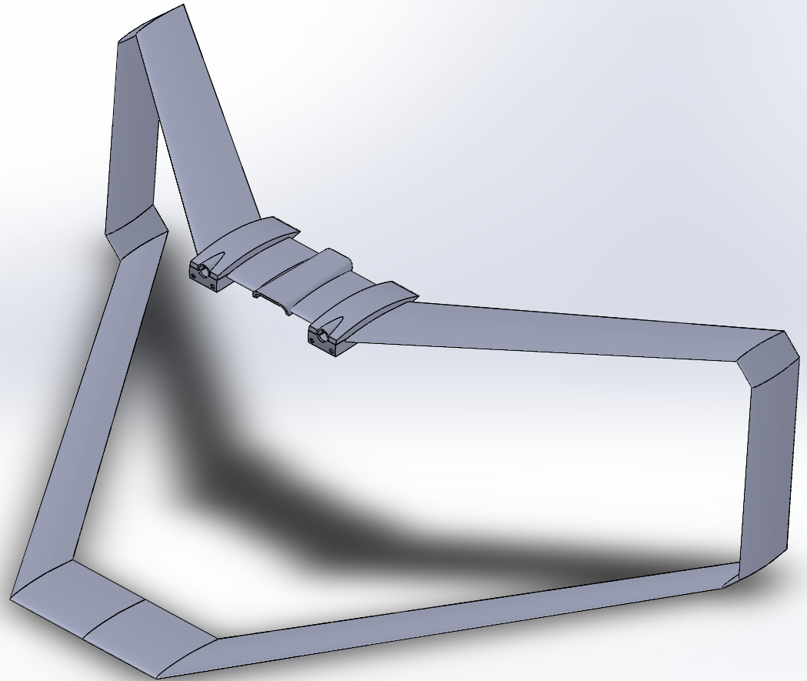
Building of the Wings and Final Testing
We are going to be cutting the swept and box wings out
We cannot put the high aspect ratio wing on the RC plane as it is too big
Box Wing
Swept Wing

Slide 33
Design Review
Proposed Changes

Slide 34
Proposed Changes
We were originally planning on using styrofoam to build our wings
Unable to use due to manufacturing issues that may arise
Due to this, we came up with a few options:
Creating a mold and then inject styrofoam
Using blue foam and just conducting testing in the wind tunnel
Manufacturing our wings using rib and spar technique
Make wings using 3D printer

Slide 35
Design Review
Design Risks

Slide 36
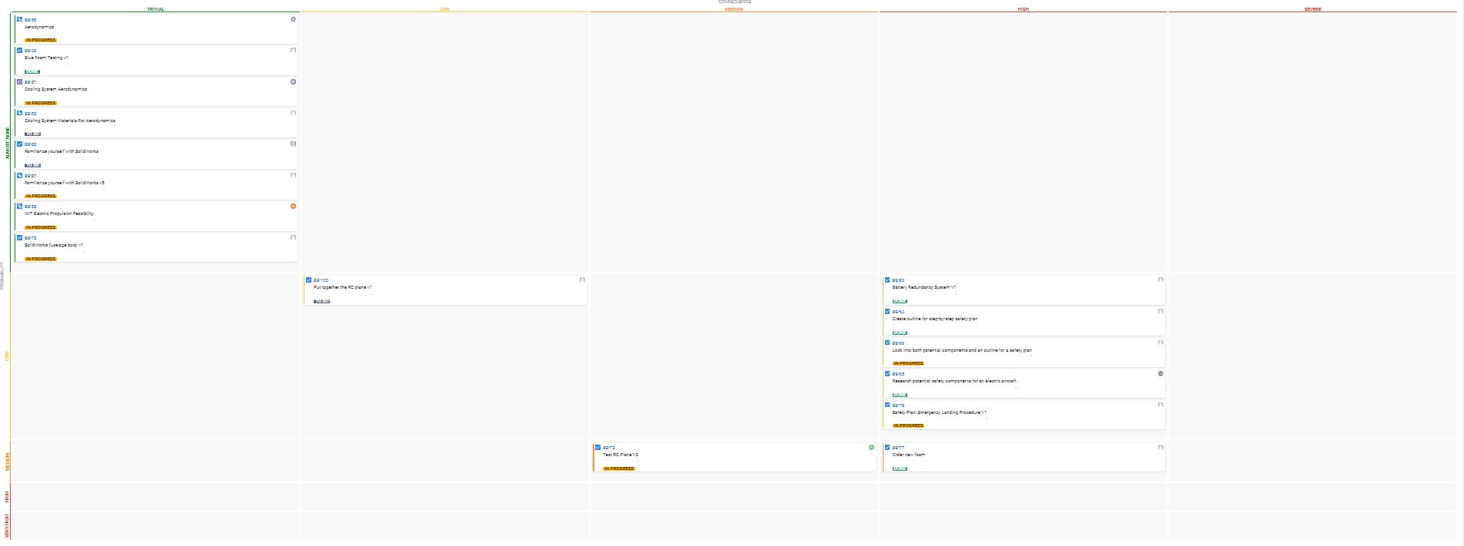
Design Risks

Slide 37
Budget
Status and requests

Slide 38
Budget Status
We currently have an expected budget of $21.78 for the semester
This was for a type of foam that we had researched that we were interested in purchasing

Slide 39
Budget Requests
Potentially need more budget for rib and spar manufacturing
Would need to purchase balsa wood
Would also need to purchase carbon fiber rods

Slide 40
Conclusion

Slide 41
Conclusion
We expect to continue:
Researching the advanced cooling system
To perform finite element analysis on our wings
Designing a model of battery packaging systems on an aircraft
To develop a safety plan that solves problems unique to electric aircraft
Researching methods to build our wings
Building wings and conducting wind tunnel testing

Slide 42
Extra Slides

Slide 43
Citations
http://news.mit.edu/2018/first-ionic-wind-plane-no-moving-parts-1121

